Slide 1
DRIVE Into Pytorch - From Basic To Advanced
Manoj Kumar Umer Farooq

Slide 2
WHAT IS PYTORCH?
PyTorch is an open-source machine learning Python library used for deep learning implementations like computer vision (using TorchVision) and natural language processing. It was developed by Facebook’s AI research lab (FAIR) in 2016 and has since been adopted across the fields of data science and ML.
PyTorch makes machine learning intuitive for those already familiar with Python and has great features like OOP support and dynamic computation graphs.
Along with building deep neural networks, PyTorch is also great for complicated mathematical computations because of its GPU acceleration. This feature allows PyTorch to use your computer’s GPU to massively speed up computations.

Slide 3
WHY USE PYTORCH?
PyTorch takes this accessibility one step further by behaving like standard Python.
we can use ML libraries to automatically complete calculus! ML libraries can compute any size or shape network in a matter of seconds, allowing more developers to build bigger and better networks.
Before PyTorch, developers used advanced calculus to find the relationships between back-propagated errors and node weighting. Deeper neural networks called for more and more complicated operations, which restricted machine learning in scale and approachability.

Slide 4
PYTORCH VS. TENSORFLOW
PyTorch is easier to learn
Popularity: TensorFlow is the current go-to tool for industry professionals and researchers because it was released 1 year earlier than PyTorch.
Data parallelism: PyTorch includes declarative data parallelism, in other words it automatically spreads the workload of data processing across different GPUs to speed up performance. TensorFlow has parallelism, but it requires you to assign work manually, which is often time-consuming and less efficient.

Slide 5
PYTORCH VS. TENSORFLOW
Integrations: PyTorch is good to use for projects on AWS because of its close connection through TorchServe. TensorFlow is well integrated with Google Cloud and is suited for mobile applications due to its use of Swift API.
Visualization: TensorFlow has more robust visualization tools and offers you finer control over graph settings. PyTorch’s Visdom visualization tool or other standard plotting libraries like matplotlib are not as fully featured as TensorFlow, but they’re easier to learn.

Slide 6
COMPANIES USING PYTORCH
A report from market analytics agency HG Insights shows that companies like ADP, Apple, NVIDIA, PepsiCo, and Walmart have been using PyTorch for developing deep learning models to enhance predictive analytic studies.
This large-scale adoption of the technology by major corporations has fueled the top three leading cloud providers – Amazon, Google, and Microsoft – to add cloud computing instances having a preinstalled PyTorch 1.1, thus popularizing it globally.

Slide 7
CASE STUDIES
Wadhwani AI Uses PyTorch To Empower Cotton Farmers
Lyft Uses PyTorch to Power Machine Learning for Their Self-Driving Cars
AstraZeneca Finding new ways to speed the discovery and development of new medicines
Disney uses PyTorch for animated character recognition

Slide 8
KEY BENEFITS OF PYTORCH
There’s a large and vibrant community at PyTorch.org
It’s written in Python and integrated with popular Python libraries
The scripting language, called TorchScript, is easy to use and flexible when in eager mode.
PyTorch supports dynamic computational graphs, enabling network behavior to be changed at runtime.
PyTorch has a well-regarded set of APIs that can be used to extend core functionality.
It has a large collection of tools and libraries in areas ranging from computer vision to reinforcement learning.
It supports a pure C++ front-end interface that can be used to build high-performance C++ applications.

Slide 9
PYTORCH ECOSYSTEM
The fast.ai API, which makes it extremely easy to build models quickly
TorchServe, an open source model server developed in collaboration between AWS and Facebook
TorchElastic for training deep neural networks at scale using Kubernetes
PyTorch Hub, an active community for sharing and extending cutting-edge models

Slide 10
SPEED AND USABILITY
The PyTorch core is used to implement tensor data structure, CPU and GPU operators,basic parallel primitives and automatic differentiation calculations
Torch.multiprocessing enables users to implement heavily parallel programs on multiple GPUs.
A reference counting scheme monitors the number of uses of each tensor — once the count reaches zero, the underlying memory is immediately freed.
A custom allocator incrementally builds up a cache of CUDA memory and reassigns it to latter allocations, thus preventing further use of CUDA APIs

Slide 11
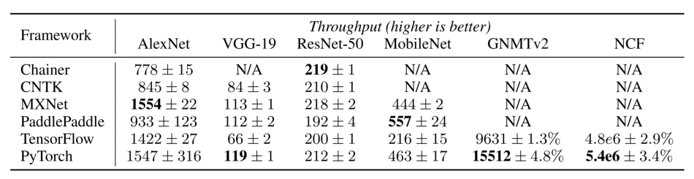
SPEED AND USABILITY
When compared with mainstream deep learning frameworks Chainer, CNTK,MXNet, PaddlePaddel, and TensorFlow, PyTorch scored within 17 percent of the fastest framework on all six benchmarks.

Slide 12
CLASSIFICATION PROBLEM
Step 1 – Initialize the input and output using tensor.
Step 2 – Define the activation function (like sigmoid )
Step 3 – Initialize the parameters such as the number of epochs, weights, biases, learning rate, etc.,
This completes the creation of a simple neural network consisting of a single hidden layer and an input layer, and an output layer.
The forward propagation step is used to calculate output, while the backward propagation step is used for error calculation. The error is used to update the weights and biases.

Slide 13
DATALOADER AND DATASET
Working with large datasets requires loading all data into memory in one go. This causes memory outage, and programs run slowly.
Takes any Dataset and creates an iterator which returns batches of data.

Slide 14
TENSORS
Tensors are a specialized data structure that are very similar to arrays and matrices. In PyTorch, we use tensors to encode the inputs and outputs of a model, as well as the model’s parameters.
Tensors are similar to NumPy’s ndarrays, except that tensors can run on GPUs or other specialized hardware to accelerate computing.
Over 100 tensor operations, including transposing, indexing, slicing, mathematical operations, linear algebra, random sampling etc

Slide 15
TORCH AUTO GRAD
torch.autograd is PyTorch’s automatic differentiation engine that powers neural network training.
Neural networks (NNs) are a collection of nested functions that are executed on some input data. These functions are defined by parameters (consisting of weights and biases), which in PyTorch are stored in tensors.

Slide 16
TORCH.OPTIM
torch.optim is a package implementing various optimization algorithms. Most commonly used methods are already supported, and the interface is general enough, so that more sophisticated ones can be also easily integrated in the future.
optimizer = optim.Adam([var1, var2], lr=0.0001)

Slide 17
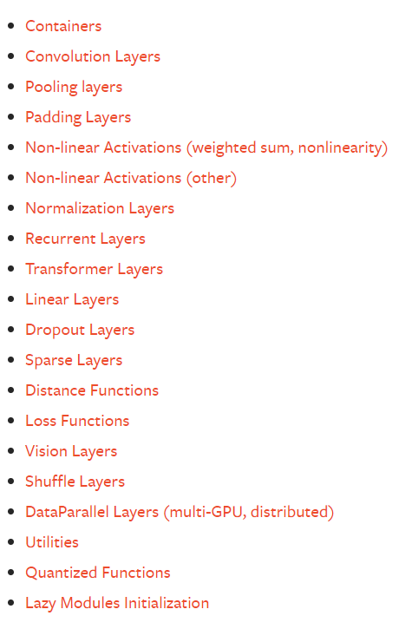
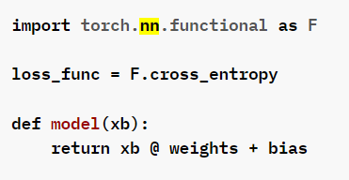
TORCH.NN
These are the basic building blocks for graphs
torch.nn provide us many more classes and modules to implement and train the neural network.

Slide 18
OPTIMIZERS
Optimizers allow you to update the weights and biases within a model to reduce error. This allows you to edit how your model works without having to remake the whole thing.
All PyTorch optimizers are contained in the torch.optim package

Slide 19
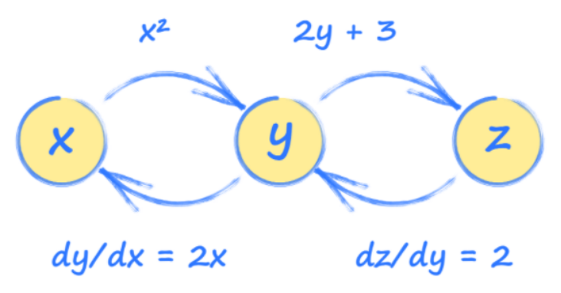
COMPUTATION GRAPHS WITH PYTORCH
Computation graphs are essentially a simplified version of neural networks with a sequence of operations used to see how the output of a system is affected by the input.
Using this graph, we can see how each tensor will be affected by a change in any other tensor. These relationships are gradients and are used to update a neural network during training.

Slide 20
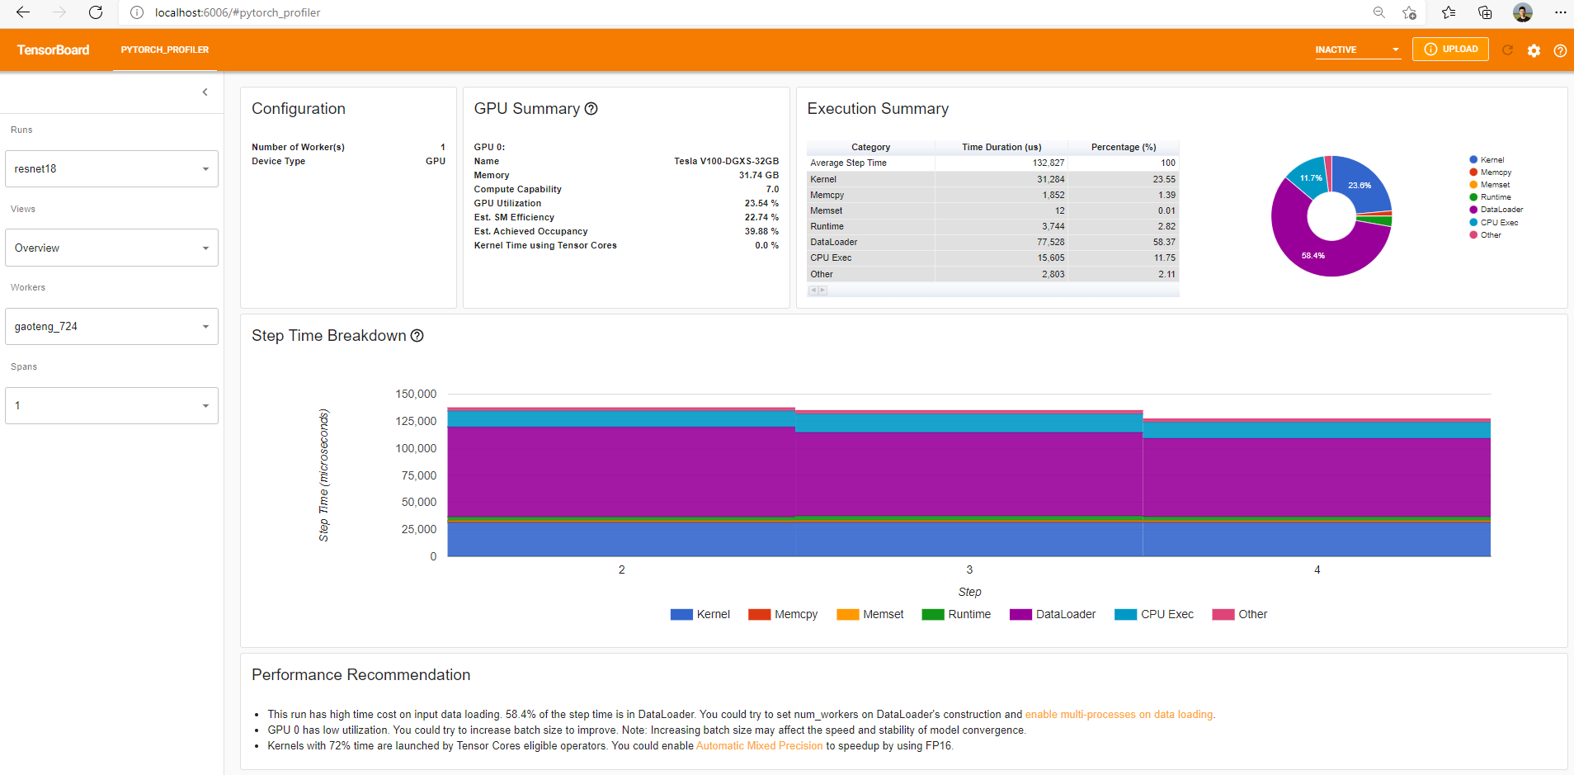
PYTORCH PROFILER WITH TENSORBOARD

